Slide 1

CAPSTONE PROJECT
HANDWRITTEN DIGIT RECOGNITION USING DEEP LEARNING
REVIEW - 3
TEAM MEMBERS:
Vasanthakumar.P(18BCS0022)
Manibharathi.S(18BCS0023)
E.Nithyashri(18BCS0070)
MENTOR:
Dr.VANITHA.M

Slide 2

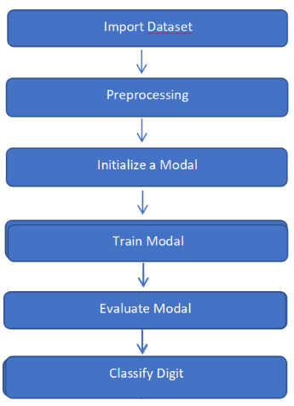


ABSTRACT
SYSTEM ARCHITECTURE
Handwritten transcription can easily be identified and understood by humans, but computer cannot identify as easily as humans because different handwriting has different patterns to spot.
This project is built based upon the most vital and integral concepts of Deep learning, Conventional Neural Networks (CNN), Support Vector Machine (SVM) along with the essential libraries and tools like Tensorflow, Keras.

Slide 3
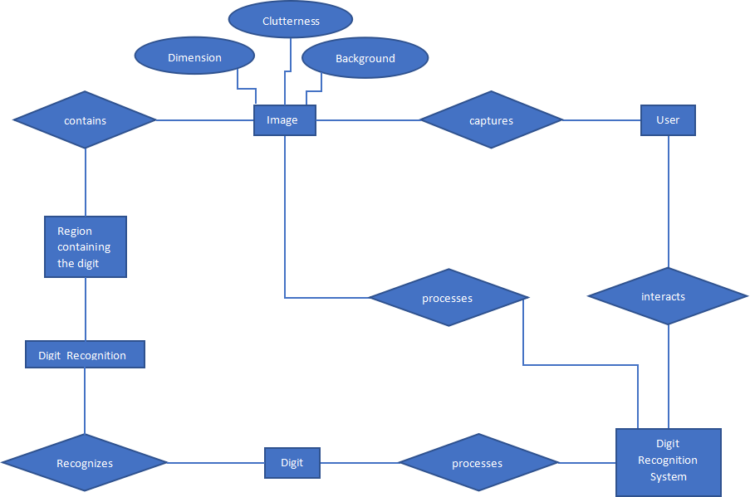
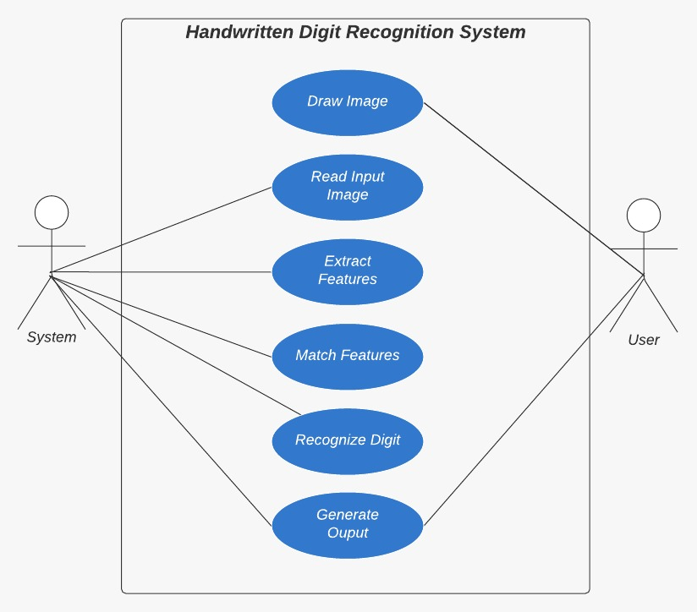
ER DIAGRAM
USE CASE DIAGRAM

Slide 4
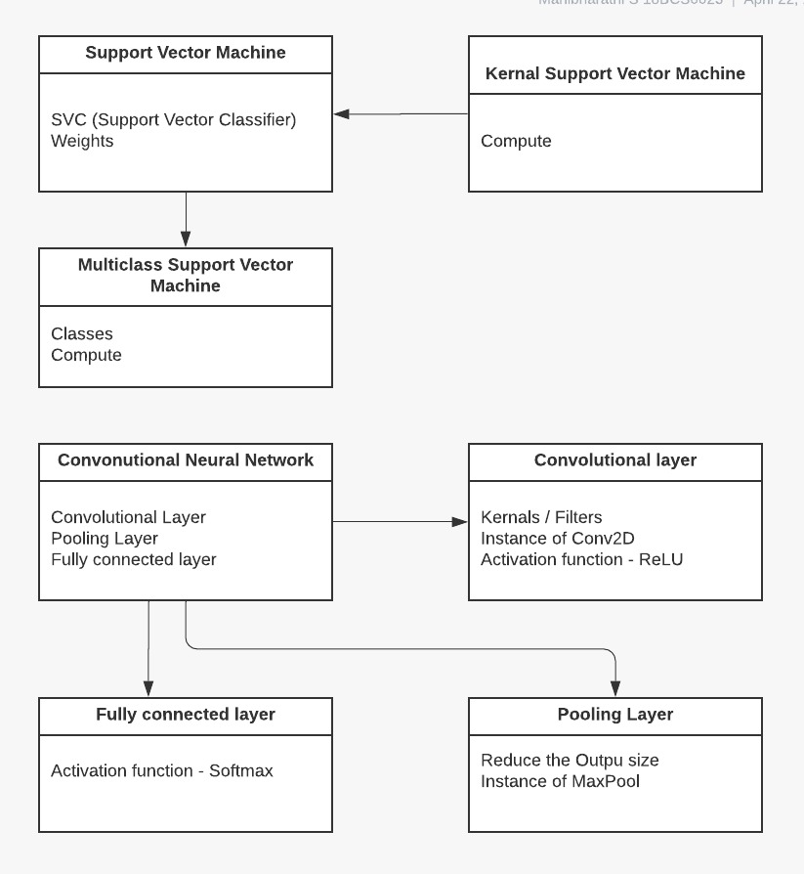
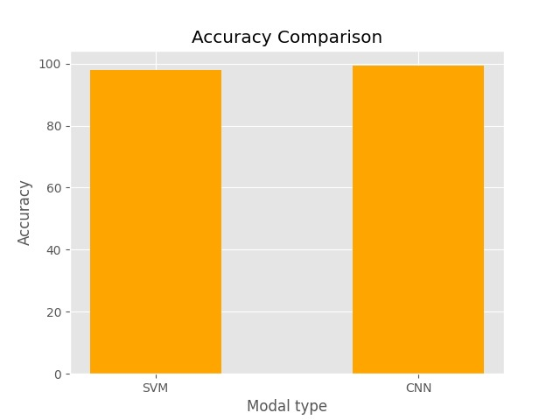
UML DIAGRAM
COMPARISON OF ACCURACIES

Slide 5
Comparison between CNN and SVM models:
Though CNN is more accurate than SVM, SVM has lesser error rates and execution time which has made us come to conclude that SVM is better than CNN.
ID | Models | Run Time(s) | Accuracy (in %) | Mean Absolute Error | Mean Squared Error | Root Mean Squared Error
1 | Convolutional Neural Network | 72.36 | 99.05 | 0.6440 | 0.4148 | 0.6440
2 | Support Vector Machine | 65.48 | 97.92 | 0.3897 | 0.1519 | 0.3897

Slide 6
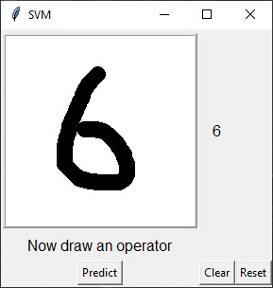
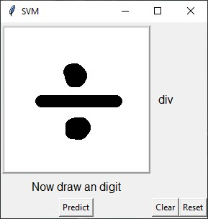
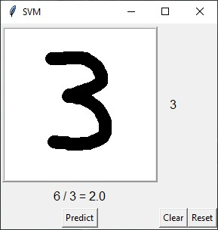
GUI- SVM
Input:
(Digit)
(Operator)
(Digit)
Output:

Slide 7
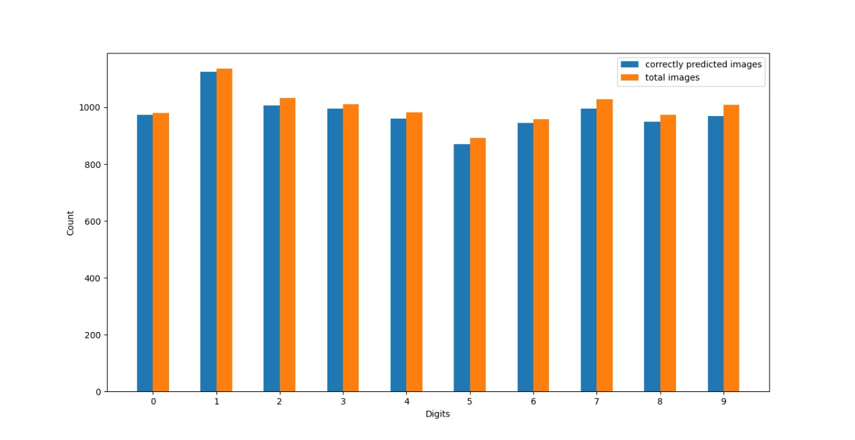
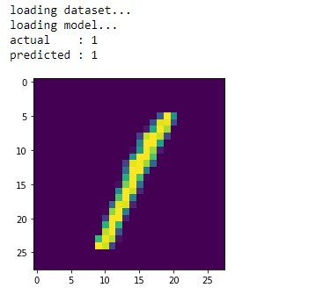
DIGITS:
Model’s prediction:
Fig: Represents the correctly predicted images out of the total images of digits by SVM

Slide 8
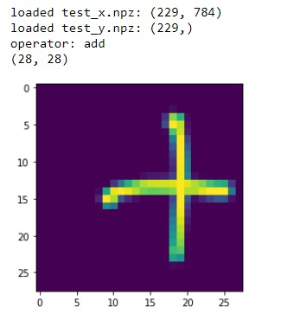
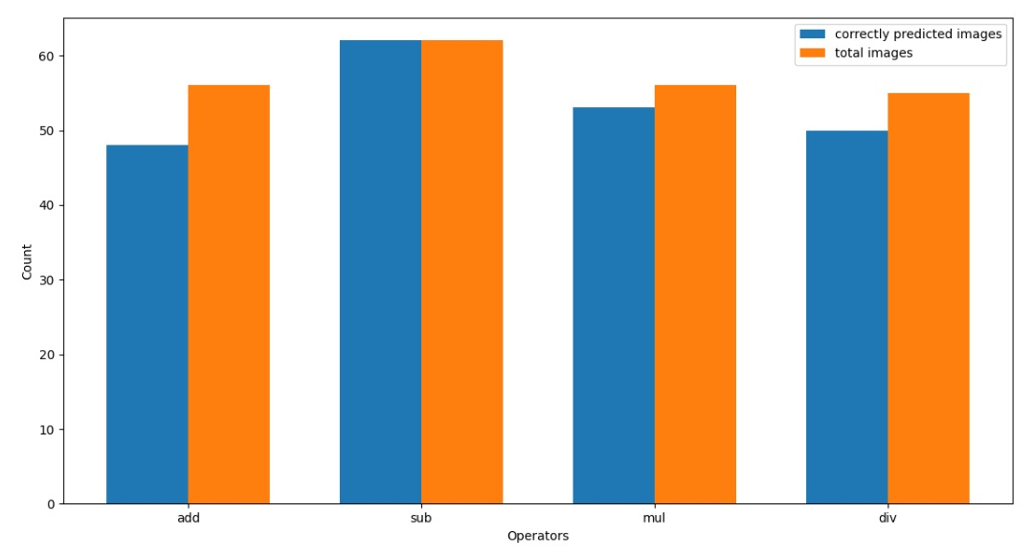
OPERATORS:
Fig: Represents the correctly predicted images out of the total images of operators by SVM
Model’s prediction:

Slide 9
LITERATURE SURVEY
[1] Comparison between the online and offline handwriting recognition using digitizer technology and various algorithms like shape recognition algorithms, preprocessing and post processing techniques, and experimental systems are done and discussed.
[2] Recognition of unconstrained handwritten text is very challenging as it is hard to segment the data. Instead of using the most approached Markov models for speech and handwriting recognition, this paper relies on a novel type of recurrent neural network(RNN) which overcomes the challenging tasks and gives accuracy of 79.7% on online data and 74.1% on offline data.
[3] It is an offline Roman cursive handwriting recognition system where the input is provided in form of a digit or a word or text. After a number of processing procedures, the ASCII format of the input is obtained as the output.
[4] This paper discusses about the character termination using a finite state automaton where an unknown stroke is compared with the database of strokes to match and identify the stroke.
[5] Components such as input interpretation, trainable segmentation, and minimum-error rate training for feature combination are used in this system, which currently supports 97 languages.

Slide 10
[6] This paper uses a novel technology for 3D handwriting recognition where accelerometers and gyroscope are attached. A Support vector machine(SVM) is used to identify the data segments whereas the Hidden Markov models(HMM) are used to generate a text representation from the captures gestures. These individual characters are concatenated to word models.
[7] Compares “one against one”(digit recognition) and “one against all”(easy to train) and found that the former is more significant. Also when compared to Multi Layer Perceptron(MLP), SVM’s strategies shows a better estimation than MLP.
[8] This paper discusses about the application of neuroevolution and therefore developing solutions based on genetic algorithms and grammatical evolution. MNIST data set consists of handwritten digits that are difficult even for humans to recognize. In spite of this, the system has produced an impressive result without any kind of data augmentation or preprocessing methods.
[9] For a modified CNN-RNN hybrid architecture, training is done using efficient initialization of network, image normalization, and domain specific data transformation.
[10] A deep neural network architecture that supports for 102 languages, has put back the segment-and-decode-based system by reducing the error rate by 20–40%. This system recognizes 10 times faster than previous system.

